Slide 1
Experience with partial simdization in open64 compiler using dynamic programming
Dibyendu Das, Soham Sundar Chakraborty, Michael Lai
AMD
{dibyendu.das, soham.chakraborty, michael.lai}@amd.com
Open64 Workshop, June 15th , 2012, Beijing

Slide 2
AGENDA
Introduction to Partial Simdization
Overview of Barik-Zhao-Sarkar Dynamic Programming-based algorithm
Motivating Example – hot loop in gromacs
Our Approach
Initial Results
Conclusion and Future Work

Slide 3
Partial simdization
Effectively utilize and exploit the SIMD (vector) ISA of modern x86 microprocessors
Traditional loop-based vectorization adopt an all-or-nothing approach in SIMDizing loops - frequently employing fission or other techniques to separate the non-vectorizable part from the vectorizable part
Partial simdization packs isomorphic instructions to SIMD instructions (if possible),
Most of the opportunities still loop-based
Need not have all instructions packed
SLP (Superworld-level-parallelism) [ Larsen et al.] one of the most well-known partial simidization techniques
A simple example of partial simdization:

Slide 4
PARTIAL SIMDIZATION - EXAMPLE
1: for (it = 0; it < n; it++) {
2: i = a[it] + b[it];
3: j = c[it] + d[it];
4: k = e[it] + f[it];
5: l = g[it] + h[it];
6: m = i + j;
7: n = k + l;
8: res[it] = m + n;
}
1: for (it = 0; it < n; it=it+2) {
2: i1 = a[it] + b[it];
3: j1 = c[it] + d[it];
4: k1 = e[it] + f[it];
5: l1 = g[it] + h[it];
6: m1 = i1 + j1;
7: n1 = k1 + l1;
8: res[it] = m1 + n1;
9: i2 = a[it+1] + b[it+1];
10: j2 = c[it+1] + d[it+1];
11: k2 = e[it+1] + f[it+1];
12: l2 = g[it+1] + h[it+1];
13: m2 = i2 + j2;
14: n2 = k2 + l2;
15: res[it+1] = m2 + n2;
}
1: for (it = 0; it < n; it=it+2) {
2: va = <a[it], a[it+1]>
3: vb = <b[it], b[it+1]>
4: vc = <c[it], c[it+1]>
5: vd = <d[it], d[it+1>
6: ve = <e[it], e[it+1]>
7: vf = <f[it], f[it+1>
8: vg = <g[it], g[it+1]>
9: vh = <h[it],h[it+1]>
10: <i1,i2> = va+vb
11: <j1,j2> = vc+vd
12: <k1,k2> = ve+vf
13: <l1,l2> = vg+vh
14: <m1,m2> = <i1,i2>+<j1,j2>
15: <n1,n2> = <k1,k2>+<l1,l2>
16: <res[it], res[it+1]> = <m1,m2>
+ <n1,n2>
}
1: for (it = 0; it < n; it++) {
2: vt1 = pack< a[it], e[it] >
3: vt2 = pack< b[it], f[it] >
4: vt3 = pack< c[it], g[it] >
5: vt4 = pack< d[it], h[it] >
6: vt1 = vt1 + vt2; <i,k>
7: vt3 = vt3 + vt4; <j,l>
8: vt1 = vt1 + vt3; <m,n>
9: m,n = unpack vt1
10: res[it] = m+n;
}
simd
scalar
Example courtesy: “SIMD Defragmenter: Efficient ILP Realization on Data-parallel Architectures”,
Y. Park et al., ASPLOS 2012

Slide 5
OVERview of barik-zhao-sarkar (BZS) algorithm
Dynamic Programming based approach
Data Dependence Graph is built for each basic block
k-tiles are built, each tile consists of k isomorphic independent operations
Two sets of costs built
Scalar Cost of each node n
Vector/SIMD Cost of k-tiles
[Pass 1] Dependence Graph traversed from source to sink, build scalar and vector costs, use dynamic programming rules
[Pass 2] Best costs are determined , decide between whether a k-tile should be SIMDized or not
Use scalar cost vs vector cost comparison for this purpose
[Pass 3] Generate SIMD+scalar code

Slide 6
barik-zhao-sarkar (BZS) algorithm - ILLUSTRATED
Various combinations of packing ( assume 2-tiles) possible
<ld a[it], ld b[it]> OR <ld a[it], ld c[it]> OR <ld a[it], d[it]> OR <ld a[it], e[it]> OR <ld a[it], f[it]> …
Which is better ? Depends on whether <+₁,+₂> OR <+₁,+₃> OR <+₁,+₄> is better and so on
vcost(<+₁,+₂>) = vcost(<ld a[it], ld c[it]>) + vcost(<ld b[it], ld d[it]>) OR
vcost(<+₁,+₂>) = vcost(<ld a[it], ld b[it]>) + vcost(<ld c[it], ld d[it]>) + unpcost(a,b)+unpcost(c,d)+ pcost(a,c)+pcost(b,d) ( Dynamic Programming)
In actuality,
Total Scalar Cost = 20
Total Vector Cost = 21
DON’T SIMDIZE
st r[it]
Scalar Code
+
+
+
st i
st j
st k
st l
SIMD Code
+
1
+
2
+
3
+
4
ld a[it]
ld b[it]
ld c[it]
ld d[it]
ld e[it]
ld f[it]
ld g[it]
ld h[it]

Slide 7
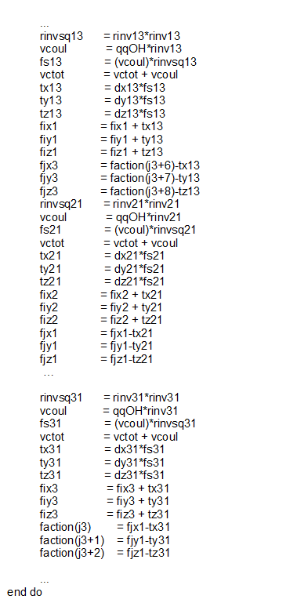
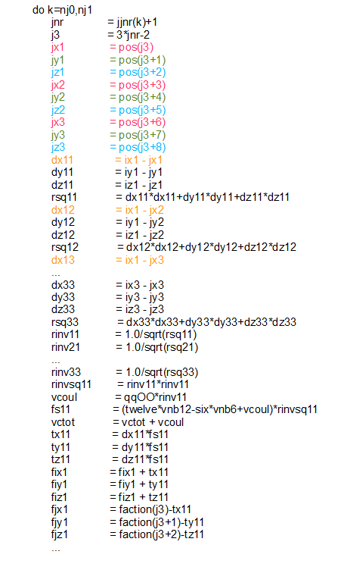
A Motivating example – hot loop in gromacs
< jx1, jx2, jx3 >
< jy1, jy2, jy3 >
< dx11, dx12, dx13 >

Slide 8
OUR APPROACH
Level 0
Phase I
Initialization (Preparatory phase)
Build the Data Dependence Graph ( still basic-block oriented ), only for INNER loops, preferably HOT
Topological sort and create levels ( provision to do ALAP or ASAP )
Difference with BZS approach which is ready-list based
We statically build all the possible tiles to control compile cost and ease of design
LDID ix1
ILOAD
pos[j3]
ILOAD
pos[j3+1]
ILOAD
pos[j3+8]
LDID iy1
LDID iz3
…
STID jx1
STID jy1
STID jz3
Level 1
…
LDID jx1
LDID jy1
LDID jz3
SUB
SUB
SUB
STID dx11
STID dy11
STID dz33
LDID dy11
…
LDID dx11
LDID dx11
LDID dy11
LDID dz33
LDID dz33
MPY
MPY
MPY
ADD
ADD
STID rsq11

Slide 9
OUR APPROACH
Phase II
Tiling
Pack isomorphic operations as k-tiles
In BZS k = SIMD width / scalar op width , ex: for simd width = 128, scalar = int, k = 4
Not the best mechanism to pick k
Iterative process, k = 2,3,4 …
Traverse through every level in topological order
Pick k nodes with isomporphic ops , create k-tile <op₁,op₂, …, op_{k}>
Associate a dummy cost with the tile
Not all isomporphic nodes at the same level checked for packing, too computationally intensive
Use heuristics, ex: nodes with common parent/grandparent not packed OR pack nodes which appear as the left child, right child etc.

Slide 10
OUR APPROACH
Phase III
Dynamic Programming
Traverse from Level = 0 (source) to Level = maxLevel (sink)
Build all the scalar costs, scost(n) for every node n
Build the simd costs of the k-tiles based on dynamic programming rules
For each tile choose the best vector cost option at any point, store the configuration
Pick Best Costs/Configuration
Traverse from Level = maxLevel(sink) to Level = 0
Pick k-tiles and chose those where vcost(tile) < Σ scost(node that is part of the tile)
The non-chosen tiles are assumed to be scalar operations
The chosen tiles are the SIMD ops
scost(n) =scost(lchild(n))
+ scost(rchild(n)) + op(n)
scost(n) = vcost(t₁) + vcost(t₂) +
unpcost(t₁) + unpcost(t₂) + op(n)
n
n
lchild(n)
rchild(n)
lchild(n)
rchild(n)
Tile: t₁
Tile: t₂
Tile: t
o¹
o²
o^{k}
Tile: t₁
o₁¹
o₁²
o₁^{k}
Tile: t₂
o₂¹
o₂²
o₂^{k}
vcost(t) = vcost(t₁) + vcost(t₂) +op(t)

Slide 11
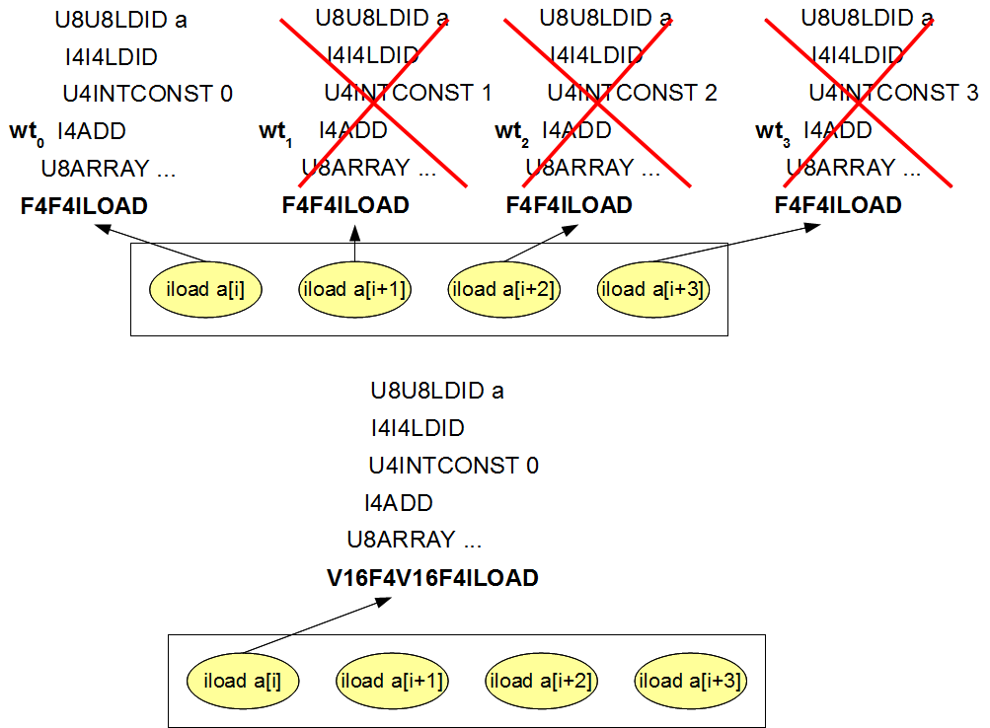
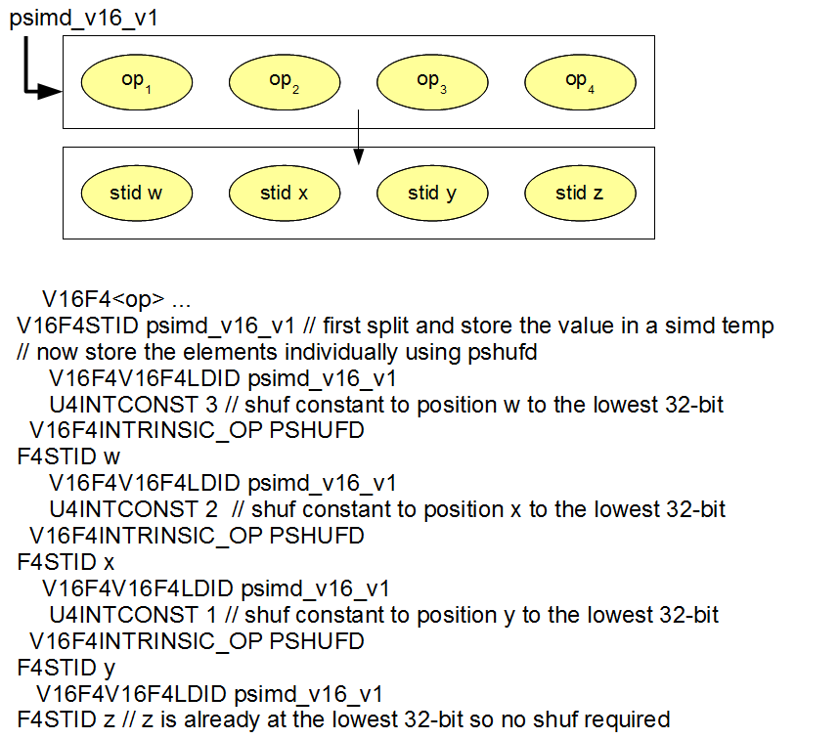
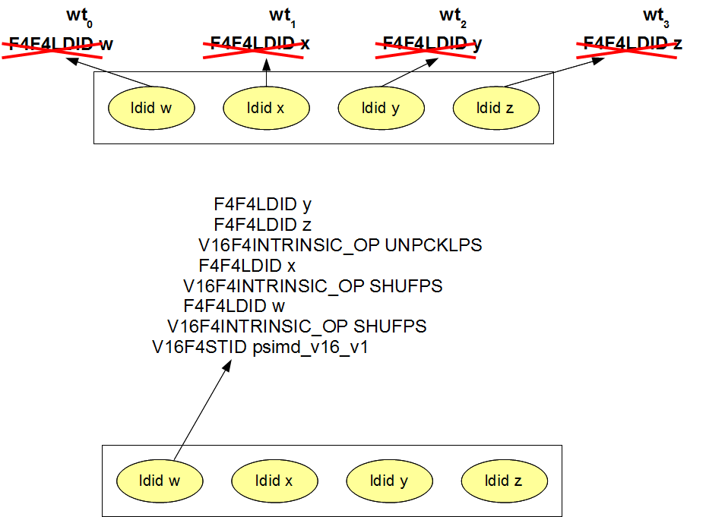
OUR APPROACH
Phase IV
Code Generation
Generate WHIRL vector types for SIMD tiles
Generate unpacking/packing instructions at the boundary of non-SIMD to SIMD and SIMD to non-SIMD code generation
Use SIMD intrinsics for packing/unpacking
Case I – General Case
Case 2 – Handling LDID/ILOAD tiles (also packing)
Case 3 – Handling STID/ISTORE tiles (also unpacking)
Arbitrary packing/unpacking not allowed
Case 1
Case 3
Case 2

Slide 12
Applysimd algorithm
Input: WN - the WHIRL Tree of the loop
Output: Simdized WHIRL Tree
Procedure ApplySimd() {
1: // Phase-I
2: /* Initialization: create the DAG from the WHIRL using data flow analysis. */
3: _dag = CreateDAG();
4: /* level creation in DAG: topological ordering of the DAG nodes.*/
5: _setOfLevels = CreateLevelsForDAG();
6: // Phase-II
7: /* possible vector tiles are created for each level. */
8: _setOfTiles = CreateVector KTilesForLevels();
9: // Phase-III
10: /* scalar and vector costs are computed according to
11: the defined cost function using dynamic programming */
12: _setOfTiles< scost, vcost > = Find KTileSimpleBestCost();
13: /* choose the best set of tiles for maximal benefits */
14: _chosenSetOfTiles< scost, vcost > = FindBestVectorScalar Ktiles();
15: // Phase-IV
16: /* generate the simdized code by transforming the WHIRL */
17: _simdizedWHIRL = GenerateVectorScalarCode KTile();
}
Phase-I
- Create dependence DAG among operations from
data dependence graph.
Create topological levels for the DAG nodes.
Phase-II
- At each level
* for each operator having n DAG nodes
> creates tile combos where k is the tile size.
Phase-III
-Compute scalar and vector cost for all tiles as per
cost model following dynamic programming
approach.
Choose the best set of tiles with minimum cost for
maximal benefit.
Phase-IV
Generate the simdized WHIRL code from which
code generator generates simdized code in
consequent compiler phase.

Slide 13
OUR APPROACH – Major differences with BZS
Level-based DAG approach to create tiles
More restricted compared to BZS which rely on an ‘ready list’ but helps control compile-time
Implemented in the LNO
Higher level implementation helps reason about the simidization implementation than bother about low-level details.
Easy vector type support in WHIRL which can be lowered
Iterative ‘k’-tiling as opposed to a rigid selection of ‘k’
Helps with the natural structure of the loop

Slide 14
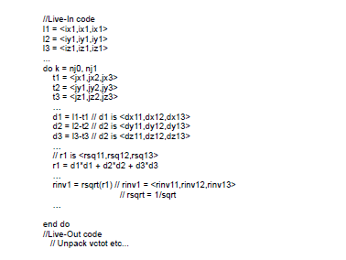
INItial results & experiments - GROMACs(inl1130)
Inl1130’s innermost loop hottest at 70%+
Loop body demonstrates 3-way parallelism, ideally suited for 3-tiling
Several complexities over the implementation outlined
Simdizing reductions
Supertiling ( identify some special patterns for better code generation )
LiveIn, LiveOut Code Generation
#Nodes | #Levels | #Nodes Simdized | #Simdized tiles | %Simdized
763 | 43 | 678 | 226 | 88.8

Slide 15
INITIAL RESULTS & Experiments
Implemented in the Open64 4.5.1 AMD release
Enabled under a special flag –LNO:simd=3 at –O3 and above
ApplySimd invoked in LNO, after regular vectorization fails
LNO/simd.cxx – code home
Compile-time intensive due to explicit tile creation
Our main targets are gromacs (inl1130) (and namd, WIP)
Not available in open64.net yet
Targets AVX, though 256 bit registers not utilized yet

Slide 16
CONCLUSION & FUTURE WORK
Illustrates the efficacy of the dynamic programming approach
First top-of-the-line compiler to effectively simdize gromacs with such huge gains
Some efforts do simdize gromacs but uses old legacy compilers like SUIF
Can be extended to CFGs
Iterative “k”- tiling factor decided on percentage simdized
The underlying graph problem is identifying subgraph-isomporphism (hard). Refer to the paper in Slide 2 by Mahlke et al.
Should we look at disjoint clusters before tiling ?
Still lot of work
Challenges in reducing compile time overhead
Code Generation too tied to the ISA (virtual vectors may help, see Zaks et al.)
Scatter/Gather operations may make things attractive (Haswell, future AMD processors)

Slide 17
REFERENCES
Efficient Selection of Vector Instructions using Dynamic Programming. Rajkishore Barik, Jisheng Zhao, Vivek Sarkar (Rice University), MICRO 2010.
Efficient SIMD Code Generation for Irregular Kernels. Seonggun Kim and Hwansoo Han Sungkyunkwan University, PPoPP 2012.
A Compiler Framework for Extracting Superword Level Parallelism. Jun Liu, Yuanrui Zhang, Ohyoung Jang, Wei Ding, Mahmut Kandemir, The Pennsylvania State University, PLDI 2012.
SIMD Defragmenter: Efficient ILP Realization on Data-parallel Architectures. Yongjun Park (University of Michigan, Ann Arbor), Sangwon Seo (University of Michigan, Ann Arbor), Hyunchul Park (Intel), Hyoun Kyu Cho (University of Michigan, Ann Arbor) and Scott Mahlke (University of Michigan, Ann Arbor), ASPLOS 2012.

Slide 18
Trademark Attribution
AMD, the AMD Arrow logo and combinations thereof are trademarks of Advanced Micro Devices, Inc. in the United States and/or other jurisdictions. Other names used in this presentation are for identification purposes only and may be trademarks of their respective owners.
©2011 Advanced Micro Devices, Inc. All rights reserved.

